Slide 1
H0TEL ROOM BOOKING SYSTEM
N.SAI PRAVALLIKA 24KB1A05BP
N.ANUSHKA 24KB1A05BF
N.RUPA SRI 24KB1A05BV
N.DIVYA LAKSHMI 24KB1A05CF
Bachelor Of Technology
In
Computer Science And Engineering
SECTION :-B
NBKR INSTITUTE OF SCIENCE AND TECHNOLOGY
(AN AUTONOMOUS INSTITUTE)
VIDYANAGAR-524 413 , TIRUPATI DISTRICT : AP

Slide 2
INTRODUCTION ON PROJECT
The rapid advancement of information technology has significantly transformed the way businesses operate across various industries, including hospitality.
One of the most impactful innovations in this sector is the development of Hotel Room Online Booking Systems. These systems provide a platform through which customers can conveniently browse available accommodations, compare prices, view amenities, and make reservations from anywhere at any time .
A Hotel Room Online Booking System is designed to automate and streamline the reservation process, eliminating the need for manual booking via phone calls or in-person visits.

Slide 3
Hotel Room Booking System
A hotel room online booking system is a software platform that allows customers to reserve rooms in hotels over the internet.
Main Features for Guests :Search and Filter: Find hotels by location, dates, price, amenities, etc.
Room Selection: View room types, prices, photos, and availability.Booking and Payment: Securely reserve rooms and pay using credit/debit cards or other payment gateways.
Confirmation and Email Receipts: Immediate booking confirmation sent to email.User Accounts: Allows guests to manage bookings, cancelations, and preferences.
Main Features for Hotel Staff/Admins:Room Management: Add/edit room types, availability, pricing.
Booking Management: View, modify, or cancel reservations.Customer Management: Store guest details, preferences, and history.

Slide 4
Previous Projects
Frontend (User Interface)
Backend (Server-side Logic)
Database
Authentication And Security
Apis & Integrations
Booking Logic
Hosting & Deployment
Optional Advanced Features

Slide 5
Technologies
Technologies used:
Handles business logic, user authentication, and database
Data base Stores hotel listings, bookings, user information,
Relational Databases: MySQL, PostgreSQLNoSQL
Databases: Mongo DB (if flexibility is needed)

Slide 6
DEVELOPMENT
Hosting & DeploymentCloud Providers: AWS, Google Cloud, Microsoft AzurePaaS: Heroku, Vercel, Netlify (for front-end)CI/CD Tools: GitHub Actions, Jenkins8. Optional Advanced FeaturesAI Chatbot for customer service (e.g., Dialogflow)Mobile App (React Native, Flutter)Admin dashboard (using React Admin or custom solution)

Slide 7
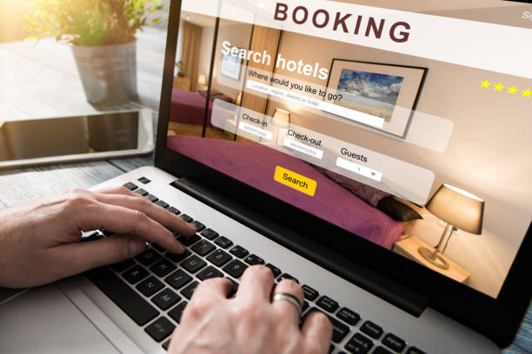


Slide 8
ADVANTAGES
24/7 Accessibility: Guests can book rooms anytime, from anywhere, without depending on front desk hours.
Real-Time Availability: The system updates room availability instantly, reducing the risk of overbooking .
Convenient User Experience: Customers can easily compare rooms, prices, and amenities through an intuitive interface .
Increased Bookings: Online exposure attracts a wider audience, including international.
Payment Integration: Secure, upfront payment options reduce cancellations and streamline the check-in process .
Cost and Time Efficiency: Automates reservation handling, reducing manual work and human error

Slide 9
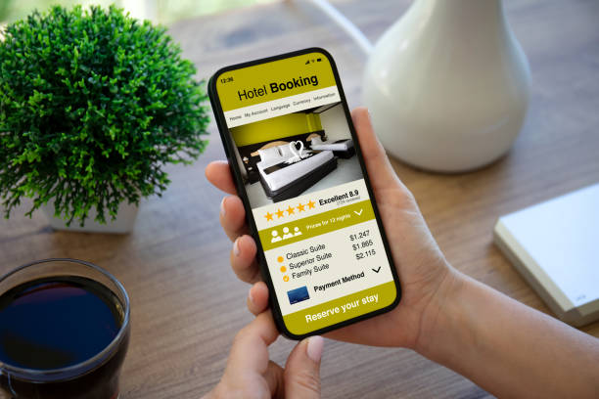
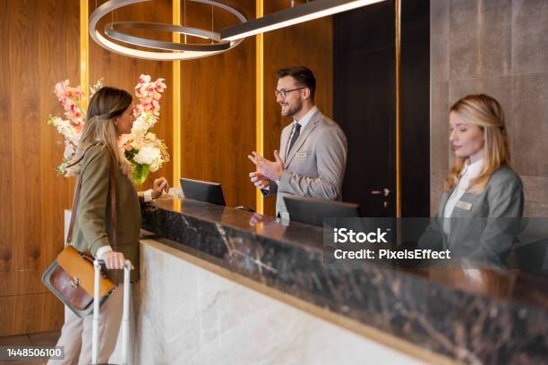

Slide 10
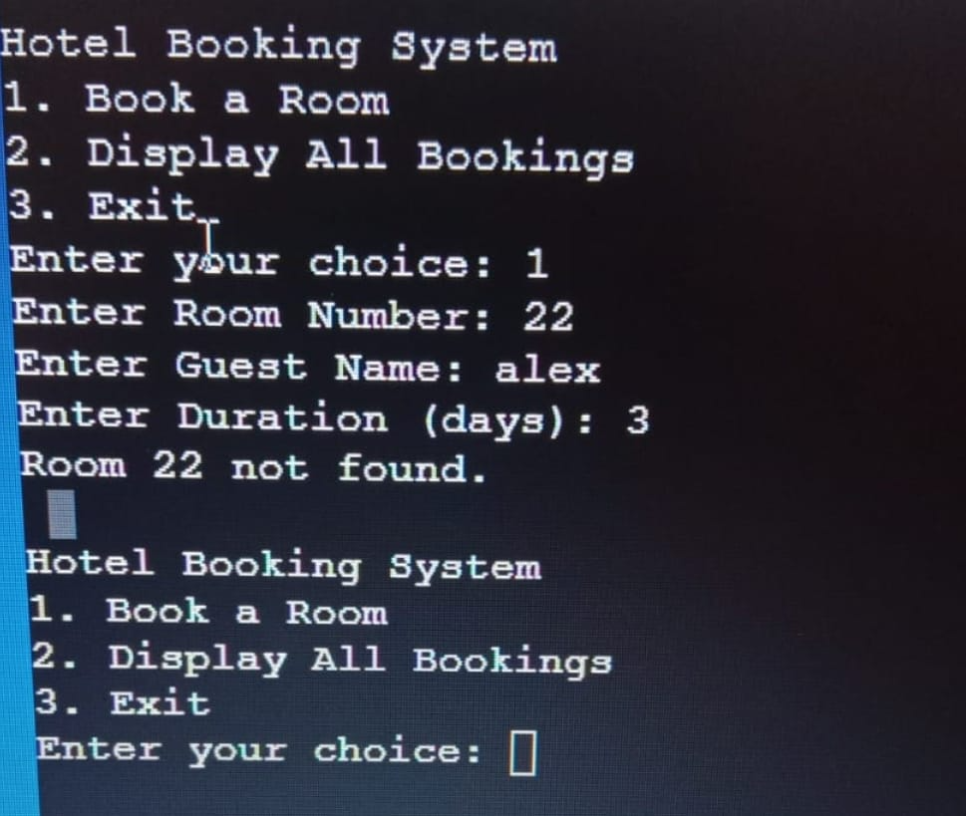
OUTPUT

Slide 11
Conclusion
The Hotel Room Online Booking System significantly enhances the efficiency and convenience of hotel management and guest reservation processes.
By providing an easy-to-use platform for customers to check availability, compare room options, and book accommodations online.
The system reduces the dependency on manual processes and minimizes human error.

Slide 12
ANY QUERIES
Feel free to ask any questions about the project!

Slide 13
THANK YOU..........

